Slide 1
Meeting 120213
Short term (February)
Workshop organization
Long term
Holder + TEER (end of march)
TEER voltmeter (AD5933) (june)
Pump module for MultiDyn (june-july)

Slide 2
Meeting 120213
Short term (February)
Workshop organization
Duration: 3 days
Sponsorshiped by CNR of Pisa
Partecipants:
Margherita La Marca
Daniele Cei
Federico Vozzi (?)
Tommaso Sbrana
Candida Nastrucci
Theoretical session (morning)
Practical session (afternoon)

Slide 3
Meeting 120213
Short term (February)
Workshop organization
“….The participants (max. 20) will be divided into groups of 2 people each. The goal that each group has to achieve is the establishment of an intestinal-liver model. The system is based on the co-culture of Caco-2 cells and HepG2. The first tissue is developed on a PC membrane (0.4 µm pore size), using a CM bioreactor. The second culture is developed on a 3D gelatin scaffold placed inside a MCmB. Once the cells are ready (after one day of attachment in static conditions), the bioreactors will be joined, in order to form a closed circuit. Cells viability will be evaluated using Alamar test directly inside both compartments, after one day of dynamic experiment (200 µL/min vs 100 µL/min). The Caco-2 conditions is characterized using TEER measurements before and after the dynamic experiment. Some of the groups will add silver nanoparticles (NPs) in toxic concentrations, in order to have a positive control, as compared with the experiments performed in absence of NPs. The control for each experiment will be a static experiment…”

Slide 4
Short term (February)
Workshop organization
TB + In Live Box 1
+ clamp system
Long term
Holder + TEER (end of march)
TEER voltmeter (AD5933) (june)
Pump module for MultiDyn (june-july)

Slide 5
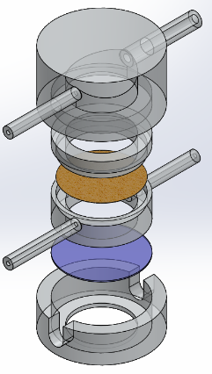
Live Box 1
Top chamber
Top cylinder
Membrane
Inner cylinder
Glass disc
Bottom housing

Slide 6
Live Box 1
  Removable glass bottom allowing for
    direct cell culture
    in situ polymerisation of photo-crosslinkable materials
    in-situ photo-stimulation of light-sensitive materials
    Live imaging
  Support for 2D/3D static and dynamic cell cultures
    Culture chamber volume resembling that of 24 well plate
    Conventional culture on the well bottom
    Transwell configuration mimicking 12 transwell insert surface
  Flow: 2 inlets / 2 outlets (one inlet/outlet pair above the interface and one below)
    Single side
    Double side (ALI or LLI cell culture)
    3D Construct perfusion (sigmoidal → upper in/lower out preferred embodiment)

Slide 7
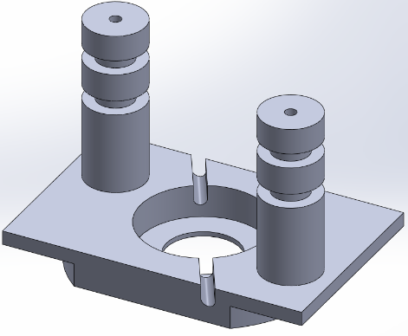
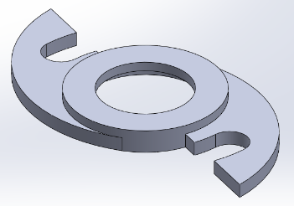
Clamp system
Wing
Base

Slide 8
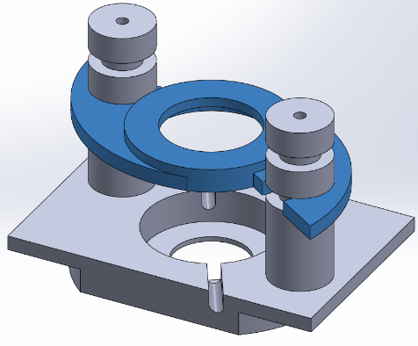
Clamp system
3D View

Slide 9
Short term (February)
Workshop organization
TB + In Live Box 1
Patent Transparent Bioreactor
Technical description of TB
Technical description of In Live box 1 (on going)
State of art (on going)
Patent clamp system
Technical description (to do)
State of art (to do)
Long term
Holder + TEER (end of march)
TEER voltmeter (AD5933) (june)
Pump module for MultiDyn (june-july)

Slide 10
Short term (February)
Workshop organization
TB + In Live Box 1
Patent Transparent Bioreactor
Technical description of TB
Technical description of In Live box 1 (on going)
State of art (on going)
Patent clamp system
Technical description (to do)
State of art (to do)
Long term
Holder + TEER (end of march)
TEER voltmeter (AD5933) (june)
Pump module for MultiDyn (june-july)
Barsoukov E., Macdonald J.R., “Impedance spectroscopy theory, experiment, and applications”, Wiley-interscience , 2005, ISBN: 0-471-64749-7

Slide 11

Daniele
Meeting 150113
Pressure tests in bioreactor
Giorgio
Live Box 1
Chiara
Training on experiments with bioreactors
?? Possibility of a flat top chamber in order to observe cells in bright field??

Slide 12
Gantt chart
April
Matherial for Chiara and training
TEER in holder: characterization with 4 electrodes
Patents
May
MultiDyn characterization (cells free)
June
TEER Voltmeter
July
pump module for MultiDyn

